Slide 1
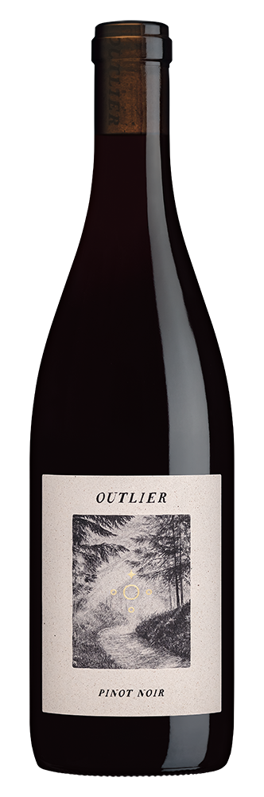


VINTAGE: 2024 | VARIETAL COMPOSITION: 100% PINOT NOIR
APPELLATION: 81% Lake County, 19% Mendocino County
HARVEST DATES: September 3,4,and 5, 2024 | RELEASE DATE: May 2026
ALCOHOL: 12.3% | PH: 3.7 | TA: 4.5 g/L
BARRELS: Aged for 19 months in used French oak barrels
COOPERAGES: Billon, Damy, Francois Freres, Rousseau, and Taransaud
CASES PRODUCED: 4,998 12 X 750ML cases
CERTIFIED SUSTAINABLE BY CSWA
At Outlier, our wines are different by design. Every aspect of our approach—from the vineyards to your glass—is thoughtful and intentional. We’re inspired by nature and are committed to being proactive stewards of the environment. That’s why we do things organically, using innovative regenerative dry-farming practices, natural pest management, and minimal intervention during fermentation. Even our approach to packaging is sustainably-minded. We want our wines to be a true reflection of the beautiful vineyards from which they come while protecting and restoring the ecosystem. We are proud to be blazing new trails in winemaking.
VINEYARD INFORMATION: This delicious wine is produced from two CCOF-certified organic vineyards in the upper reaches of Lake and Mendocino Counties. Spring Valley, a narrow ravine in the shadow of Clear Lake, is the source of most of the grapes and the cool micro-climate at Long Valley Ranch allows for the slow ripening that is so critically important when it comes to producing balanced Pinot Noir. City Vineyard grapes provide prototypical sous bois and savory complexing notes. These outlying vineyards are planted to a mix of Pinot Noir selections, including Dijon clones 114, 115, 667, 777, and 943, as well as heritage Pommard vines.
GROWING SEASON: Favorable conditions during Spring were followed by a relatively mild start to the growing season. Summertime warmth accelerated ripening in a marked way. Pinot Noir grape yields were much lighter than average and quality was excellent in 2024.
WINEMAKER COMMENTS: “Brilliant ruby red color with a swirl of rose petals, rhubarb, bing cherry, cocoa, and sandalwood aromas. Crunchy red and black fruits are at the forefront on the silken palate, with cherry cola, boysenberry, blackberry, and cara cara orange flavors. Supple, dusty tannins and uplifting acidity add depth and freshness to the wine as cinnamon, mocha, sous bois, and briny notes chime in on the nascently complex finish. This Pinot Noir perfectly captures the graceful power of the warm 2024 vintage.” —DEREK ROHLFFS, WINEMAKER
CCOF Certified
Organic Farming
CSWA Certified
Sustainable Winemaking
Recycled
Label Paper
Lightweight
Glass
No
Capsule
DIAM
Cork

